Slide 1
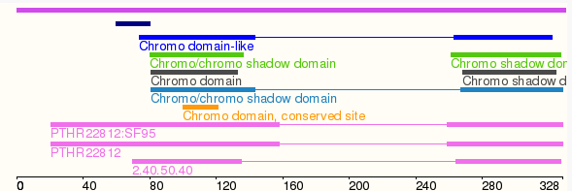
Introduction
Question: If Swi6 is supposed to bind DNA, how does it have a pI of 5 when pH of nucleus is ~7?
Goal: Analyze isoelectric point of swi6 protein
Made program to make sliding window of length n of the protein and analyze isoelectric point of smaller portions of peptide
n
n
n
Notes:
Basically I just played around with different sliding windows until I found something

Slide 2
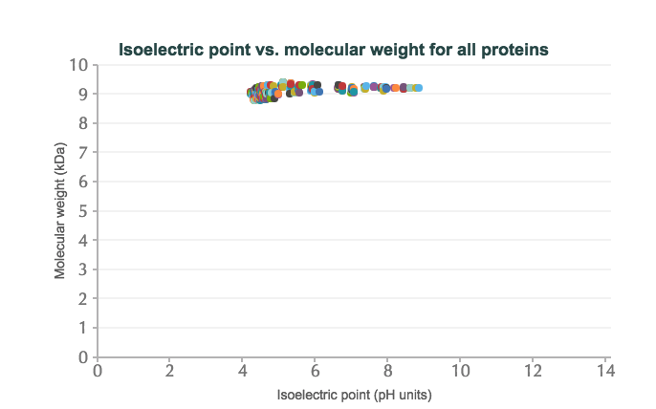
N = 80
Subset #84

Slide 3
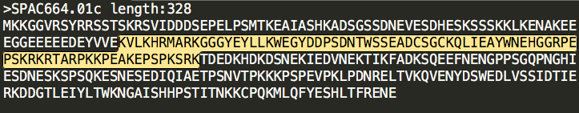
Subset 84 (highlighted) has overlap with Chromo Domain
Bounds of the Chromo Domain!
But the Chromo Domain has an overall pI of ~5 ??
So it must be the other parts of this subset that are driving pI up. Thus, if we look at smaller N, the part that is downstream of the chromo domain but is included in Subset 84 should be included

Slide 4
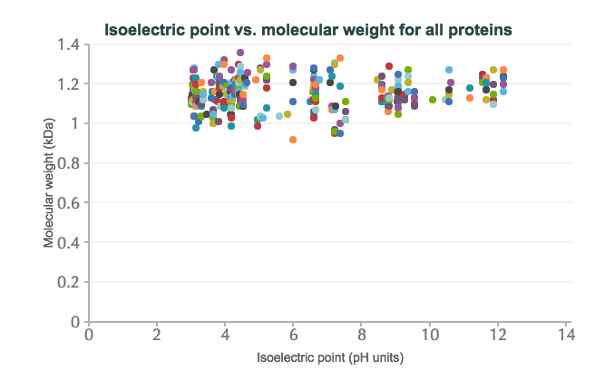
N = 10
Subset 143

Slide 5
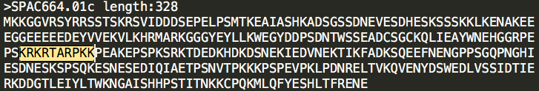
Subset 143 is a subset of Subset 84 (sorry that’s a mouthful)

Slide 6
Conclusion
I think one of the main drivers of DNA interaction with Swi6 (from a polarity perspective) is directly outside of the chromo domain
But then what does that mean for the Chromo shadow domain?? I have no clue!

